Slide 1


Suggested Country Canada Sri Lanka Australia Singapore
zomato
DATA ANALYSIS
ASHWIN DUBEY
ashwindubey1051994@gmail.com

Slide 2
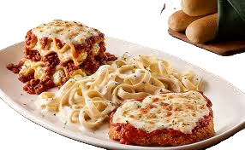
INTRODUCTION AND OBJECTIVES
Objective:
To identify Country which have potential and is good to open a new restaurant.
Analyzation of rates, cuisines, country ,city , rating, cost to grew up the restaurant which is to open.
Introduction:
In a dynamic market, strategic expansion is crucial for sustained growth. This analysis delves into comprehensive data to pinpoint optimal locations, understand market trends, and provide actionable insights for informed decision-making.
Key Components:
Objective assessment of countries and cities for new restaurant openings.
In-depth analysis of factors impacting restaurant success.
Recommendations rooted in data-driven insights

Slide 3
Suggested Country Canada Sri Lanka Australia Singapore
DATA OVERVIEW
After navigating through the dataset we have got the table name ‘Cleaned data’ have 26 column attributes. each facet holds a unique key to unraveling insights into the culinary world. From the nuanced nuances of restaurant names and locations to the palpable metrics of ratings, cost, and customer engagement, our data weaves a narrative waiting to be deciphered.
Regarding Headings:
Restaurant Identity: Unique Restaurant ID and Name emplace the identification of Restaurant.
Geographical insight: Unique Country code, Country name, position on map by attitude and altitude.
Culinary diversity: An array of cusiness which will help to attract the customer.
Service provide by restaurant : The restaurant weather takes table reservations and accepts orders online.
Cost consideration: Contains cost of items, ratings of them and average price.
Demand in globally and domestically: Food demand and cost of items all over world.
Service till now: Give a well identification of restaurant that how it withstand on believes of people till present date.

Slide 4
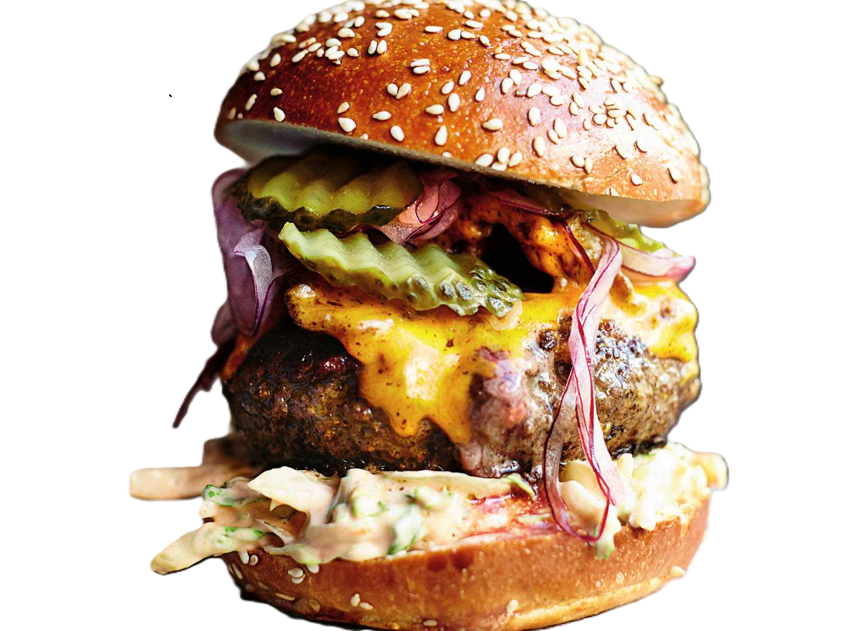
Suggested Country Canada Sri Lanka Australia Singapore
Methodology
Streamlined Approach
Data Cleansing: Thorough cleanup, from city names to format consistency.
Enrichment Strategies: Infusing country descriptions and expanding our dataset.
Analytical Framework: Excel's pivot tables, IF functions, and statistical tools.
Toolbox Overview
Statistical Analysis: Uncovering trends and patterns.
Excel Functions: Pivot tables, LOOKUP, logical operators.
Balanced Precision: Technical insights in accessible language.

Slide 5
ANALYSIS OF OBJECTIVE QUESTION
Data Overview: Explore tables, attributes, and data cleaning steps.
Geographical Insights: Examine restaurant distribution across countries and yearly openings.
Pricing Patterns: Analyze pricing trends and restaurant counts based on price range.
Popularity Metrics: Investigate voter counts and average ratings for key insights.
Conditional Analysis: Explore specific conditions and their impact on restaurant metrics.
Customized Pricing: Understand variations in average cost through customized pricing.
Array Formula Application: Discuss the use of array formulas for complex calculations.

Slide 6
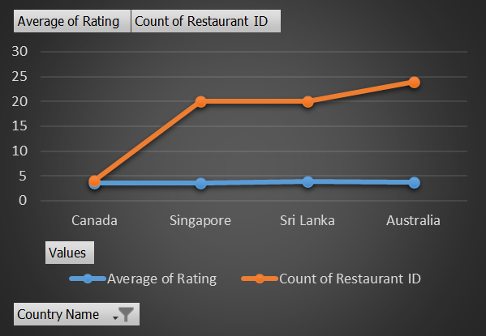




Suggested Country Canada Sri Lanka Australia Singapore
SUGGESTED COUNTRY
ANALYTICAL APPRACH:
Used a pivot table by integrating Country name, Restaurant count
and rating in an average
Analyze the rating below 4 and least restaurant count I found 4 country.
Applied filter on the 4 country and made a chart shown in right.
Strategical Insight:
Country and city where the potential of growth is higher for newer restaurant
Using average rating and lower restaurant count a rough analysis done and found
a suitable low competition area where chances is higher for increase the rating.
Using pivot table I got to know that from 7 countries there are 25 restaurant,
and in that considering rating below 4, and found four Countries that are suitable
for opening a new restaurant.
Australia
Canada
Sri Lanka
Singapore

Slide 7
Suggested Country Canada Sri Lanka Australia Singapore
CANADA
Chatem-Kent, Consort, Yorkton
Recommended Countries
with the cities
Australia
Armidale, Balingup, Dicky beach, Flaxton, Forest, Hepburn springs, Inverloch, Lakes Entrance, Lorn, Macedon , Meyfield, Middleton beach, Montville, Peynesville, Panola, Philip Island, Victor Harbor
Analytical Approach:
Utilized a pivot table by taking country , City, as row and restaurant ID as count and rating in average. Taking filter in country and selected 4 country and used conditional formatting in rating bellow 4.
Sri Lanka
Colombo
Singapore
Singapore
Strategical Insight:
Highlighted cities are preferable for entry level restaurant.
Cities are in tabular with Country so the preferred country are also analysed.

Slide 8
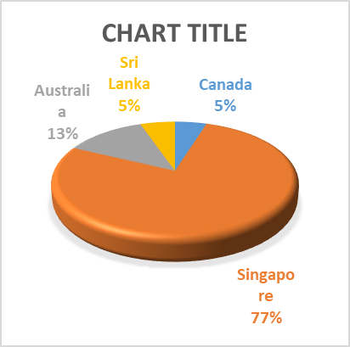
Suggested Country Canada Sri Lanka Australia Singapore
ANALYZING FOOD EXPENDITURE IN TARGET REGIONS
Canada | 12087.2
Singapore | 191884
Australia | 31229.34
Sri Lanka | 13300
Expenditure of food in suggested country
Analytical Approach:
Expenditure of food in selected country is populated as shown is calculated on the basis of INR conversion rate with summing all the restaurant available in the respected cities with ‘average cost of two’.
Strategical Insight:
Visualisation chart in ‘pie’ and a tabular table shows the expenditure in the targeted country. Clearly visualised Singapore contributes high expenditure among the 3 country.

Slide 9
Suggested Country Canada Sri Lanka Australia Singapore
COMPETITOR ANALYSIS AND NAME OF COMPETITORS
Fewer Restaurant name in suggested country
High competitors | Moderate competitors | Low Competitors
Bridge road brewers, 1918 bristo and grill, Vivo bar and grill, pig and whistle, Lake house restaurant, Ministry of crab, simply strawberry by jagro, The sizzle, Butter Boutique, Cricket club café, al’frank cookie, Fratini law trattoria, Cut by wolf gang puck. | Blue Bean Love Café, La trattoria of Lavandula, Three Anchors, funkry Monkey, Tokyo sushi, Arigato sushi, Consort restaurant, summer pavilion, Ruhbar le restaurant, Butter and love, Jaan, Café shaze, Ceoconet launge, The padington. | Star Buffet, Pier 70, Poet café, Queens café, Elite Indian Restaurant
Analytical Approach:
Strategical Insight:

Slide 10
CUISINES ANALYSIS
CUISINES WITH TOP RATINGS
CUISINES
Pizza
Mediterranean
Australian
Italian
Chinese
Bakery
Seafood
American
Continental
Desserts
Beverages
Culinary choices wield significant influence on ratings, as evidenced by a two-step analysis. The first pivot table dissects country-specific restaurant ratings, guiding adaptation to local preferences. Simultaneously, the second pivot table provides a broader global perspective, underlining the pivotal role of culinary choices in shaping customer satisfaction.

Slide 11
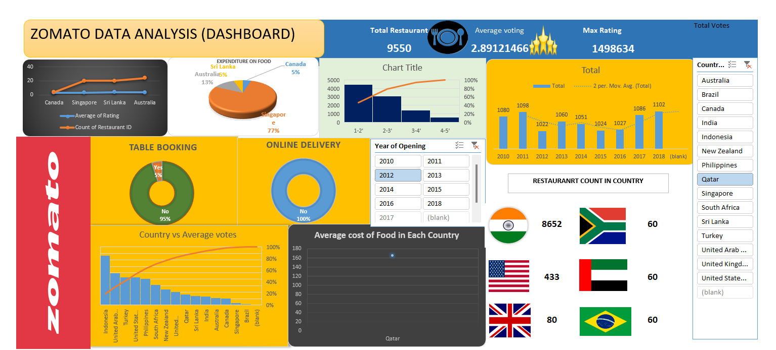
DASHBOARD

Slide 12
THANK
YOU

